Slide 1

Care for Skills: Recommender System for Education in the Care Sector
Albin vanniamparambil

Slide 2
Problem Statement
Insufficient training tools for LTC professionals.
Difficulty in finding relevant and personalized courses.
Limited use of digital and assistive technologies in the LTC sector.

Slide 3
Idea Overview
Focus: Long-Term Care Sector (LTC)
Challenges: Staff shortages Limited workforce training
Constraints: Time limitations leading to a decline in care quality
COVID-19 Gap: Lack of digital tools to aid LTC workers in skill building and person-centered care.

Slide 4
The Solution: A Recommender System
Prototype a recommender system for training and skill enhancement.
Integrate a self-assessment tool to personalize recommendations.
Popular courses Evidence for future skill needs and course shortages.

Slide 5
Technology Stack
Frontend: React,Tailwind CSS
Backend: Node.js/Express.js.
Database: MongoDB (Flexible schema, scalability).

Slide 6
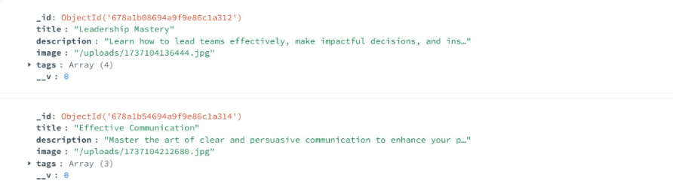
Database Design
MongoDB Schema Overview:

Slide 7
Key Features
Self-Assessment Tool: To evaluate the user’s learning goals.
Course Recommendations: Based on user preferences.
User-Friendly Interface: For ease of access and navigation.

Slide 8
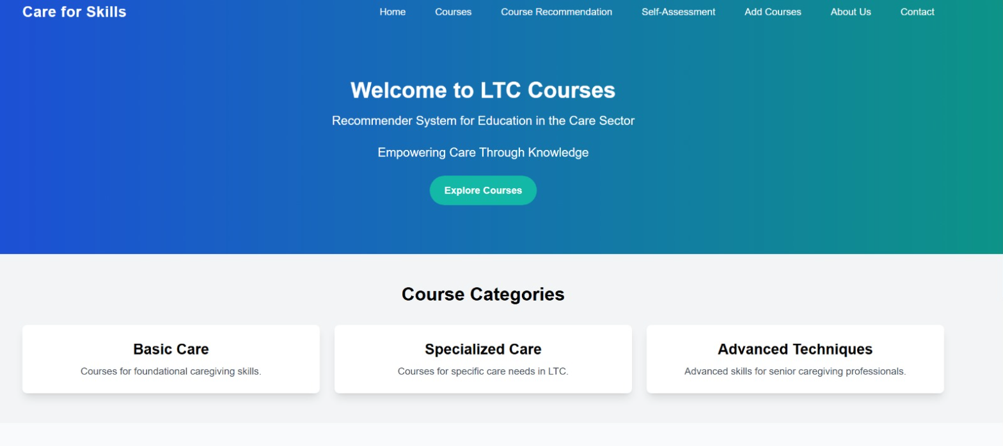
User Interface

Slide 9
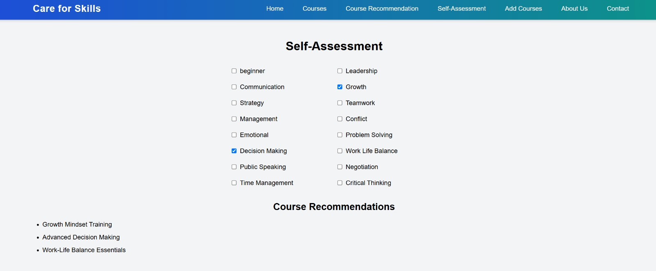

Slide 10
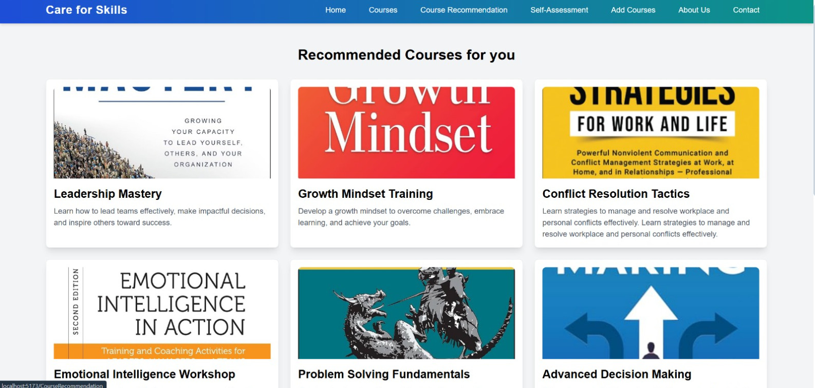

Slide 11
Thank You

